Slide 1
Topic 3. Overview of Statistical Machine Learning

Slide 2
Statistics and Machine Learning
Comparison of terminologies
Statistics | Machine learning
Classification/regression Clustering Class’n/reg’n with missing responses (Nonlinear) dimension reduction | Supervised learning Unsupervised learning Semisupervised learning Manifold learning
Covariates/responses Sample/population Statistical model Misclassification/prediction error | Features/outcomes Training set/testing set Learner Generalization error
Multiclass logistic function Truncated linear | Softmax function ReLU (rectified linear unit)
…
…

Slide 3
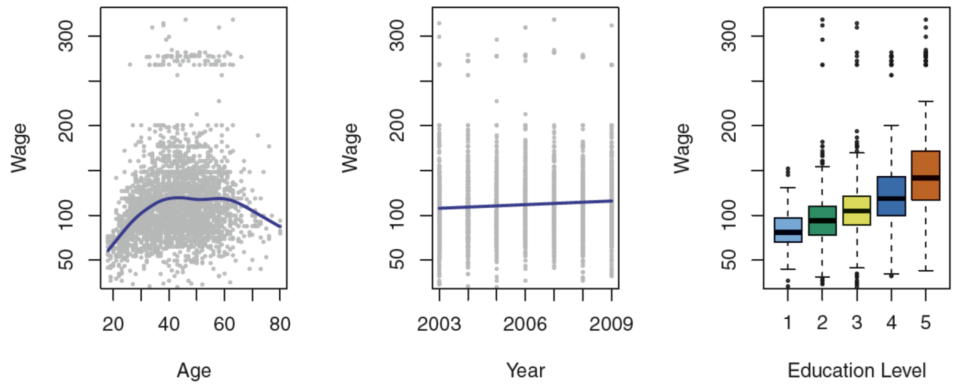
Example: Wage
Task: to understand the association between an employee’s wage and a number of factors
Note: the dataset was collected based on a group of males from the Atlantic region of the US.

Slide 4
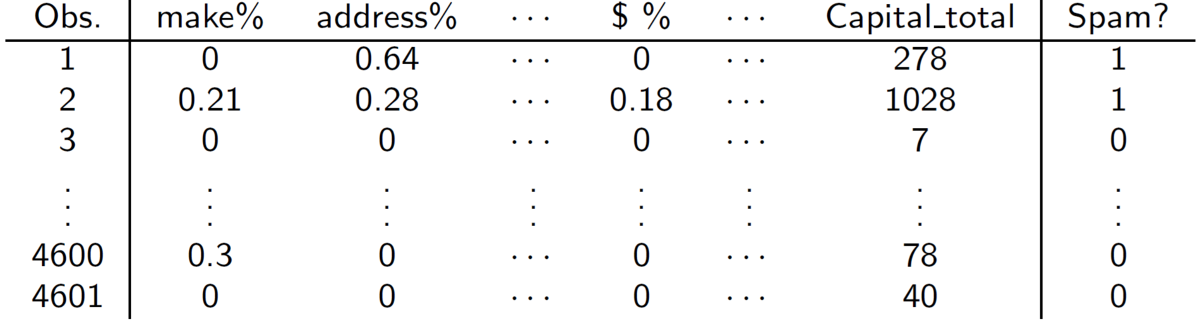
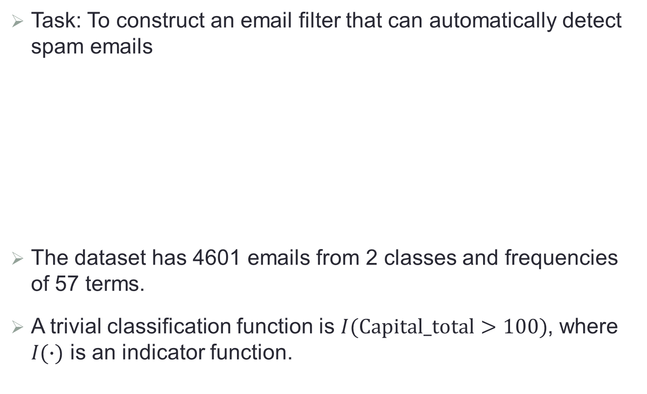
Example: Spam Detection
Task: To construct an email filter that can automatically detect spam emails
The dataset has 4601 emails from 2 classes and frequencies of 57 terms.
A trivial classification function is $I(Capital_total>100)$, where $I(∙)$ is an indicator function.

Slide 5
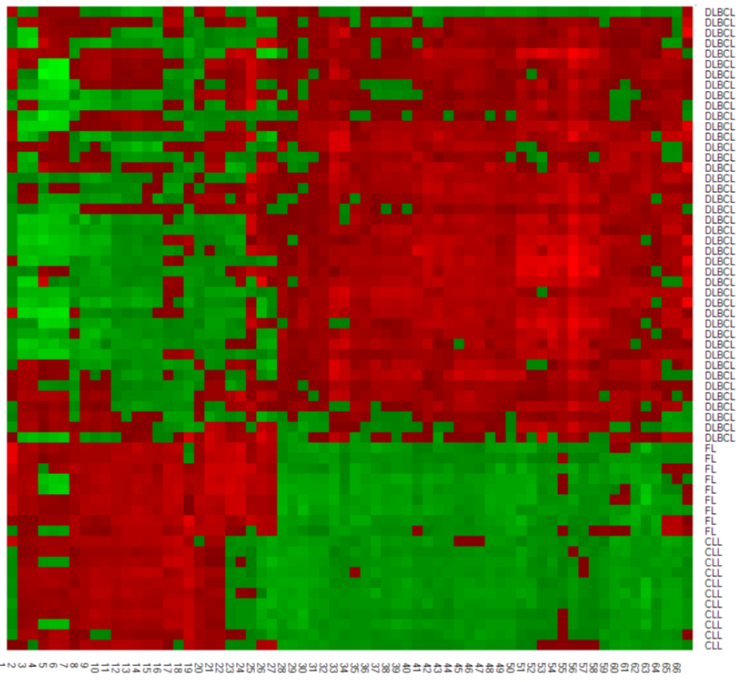
Example: Gene Microarray
Task: to construct a classifier that can automatically diagnose cancer based on patients’ genotype.
The dataset consists of 4026 gene expression profiles of 62 patients from 3 types of adult lymphoid malignancies.
Displayed are 66 “carefully” selected genes

Slide 6
Example: Gene Microarray

Slide 7

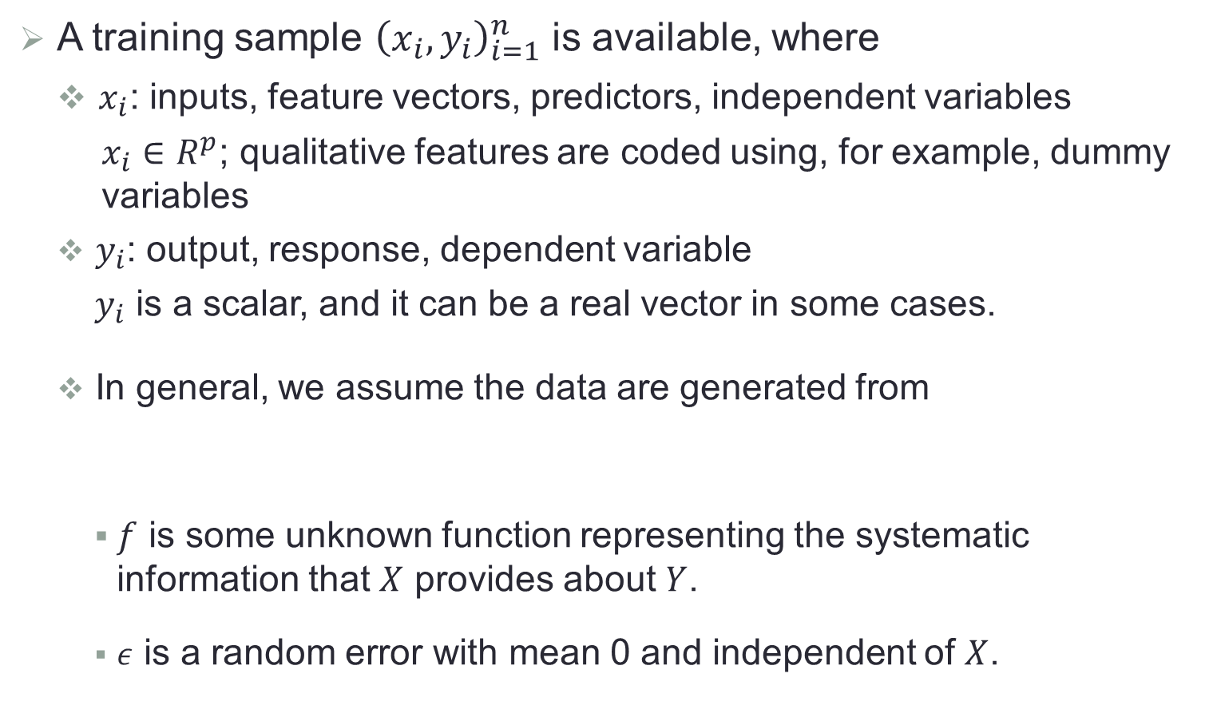
Notations
A training sample ${\left(x_{i},y_{i}\right)}_{i=1}^{n}$ is available, where
$x_{i}$: inputs, feature vectors, predictors, independent variables
$x_{i}∈R^{p}$; qualitative features are coded using, for example, dummy variables
$y_{i}$: output, response, dependent variable
$y_{i}$ is a scalar, and it can be a real vector in some cases.
In general, we assume the data are generated from
$f$ is some unknown function representing the systematic information that $X$ provides about $Y$.
$ε$ is a random error with mean 0 and independent of $X$.
$$Y=f\left(X\right)+ε$$

Slide 8
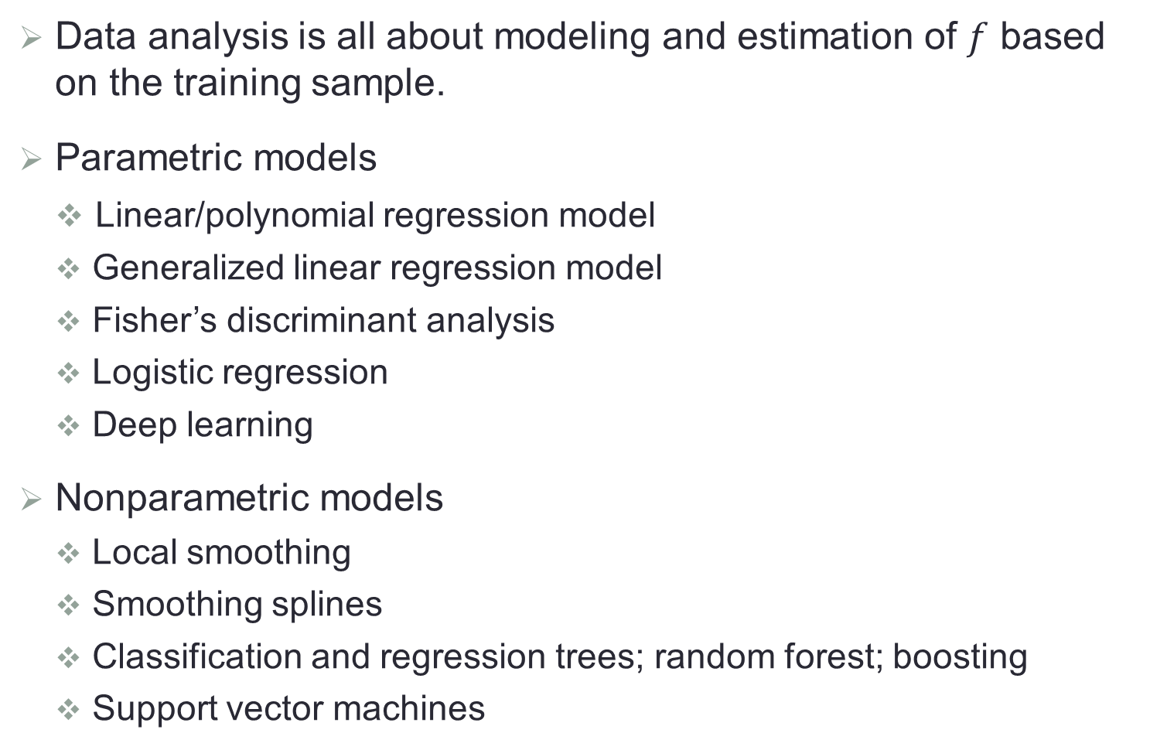
Estimation
Data analysis is all about modeling and estimation of $f$ based on the training sample.
Parametric models
Linear/polynomial regression model
Generalized linear regression model
Fisher’s discriminant analysis
Logistic regression
Deep learning
Nonparametric models
Local smoothing
Smoothing splines
Classification and regression trees; random forest; boosting
Support vector machines

Slide 9

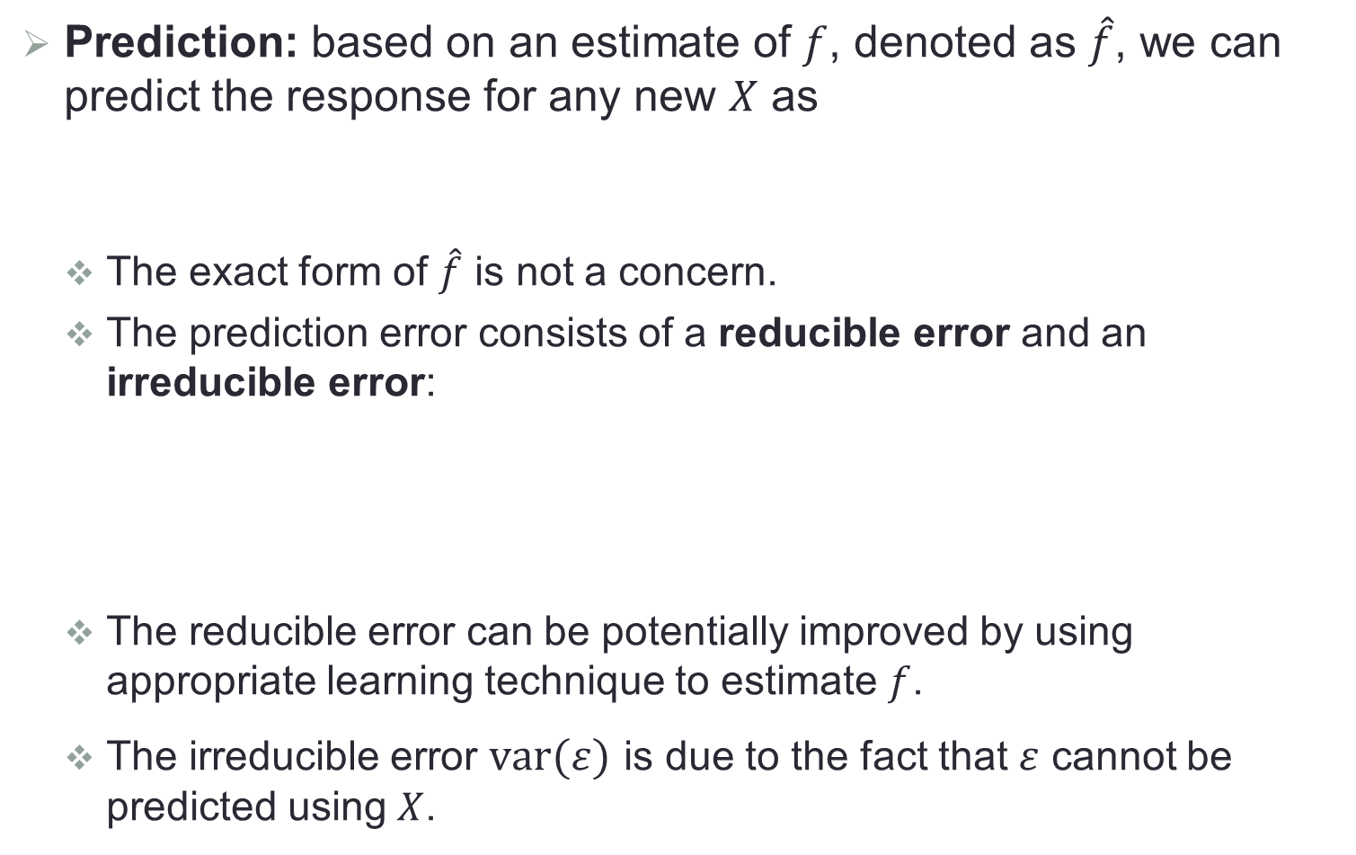
Prediction and Inference
Prediction: based on an estimate of $f$, denoted as $\hat{f}$, we can predict the response for any new $X$ as
The exact form of $\hat{f}$ is not a concern.
The prediction error consists of a reducible error and an irreducible error:
The reducible error can be potentially improved by using appropriate learning technique to estimate $f$.
The irreducible error $var(ε)$ is due to the fact that $ε$ cannot be predicted using $X$.
$$\hat{Y}=\hat{f}(X)$$
$$E{\left(\hat{Y}−Y\right)}^{2}=E{\left(\hat{f}\left(X\right)−f\left(X\right)−ε\right)}^{2}=E{\left(\hat{f}\left(X\right)−f\left(X\right)\right)}^{2}+var(ε)$$

Slide 10
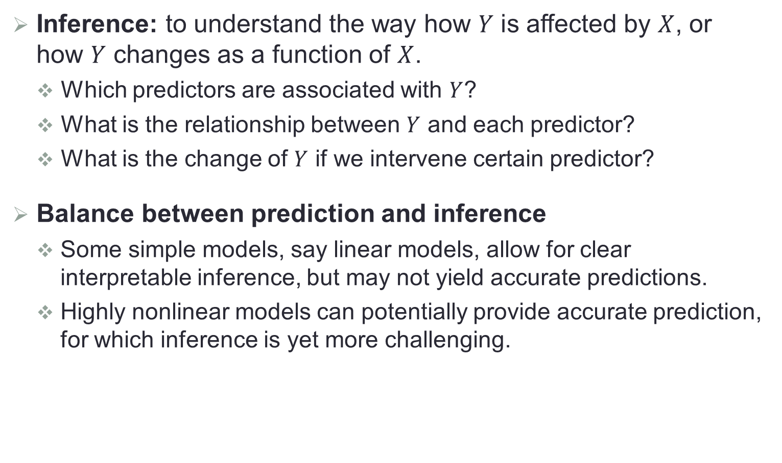
Prediction and Inference
Inference: to understand the way how $Y$ is affected by $X$, or how $Y$ changes as a function of $X$.
Which predictors are associated with $Y$?
What is the relationship between $Y$ and each predictor?
What is the change of $Y$ if we intervene certain predictor?
Balance between prediction and inference
Some simple models, say linear models, allow for clear interpretable inference, but may not yield accurate predictions.
Highly nonlinear models can potentially provide accurate prediction, for which inference is yet more challenging.

Slide 11

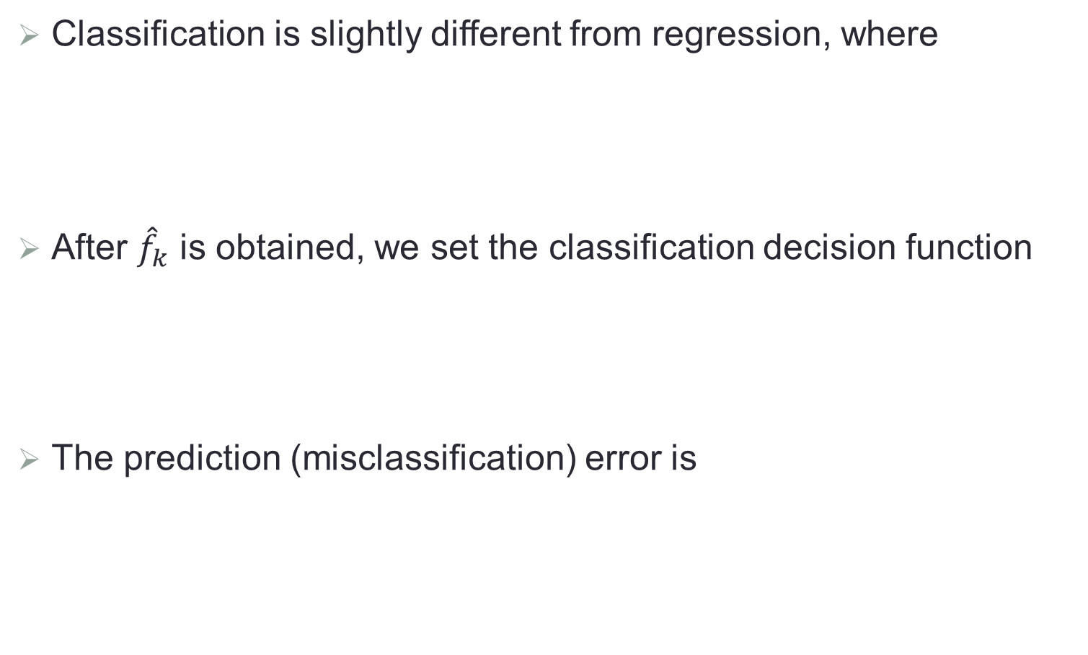


Classification
Classification is slightly different from regression, where
After ${\hat{f}}_{k}$ is obtained, we set the classification decision function
The prediction (misclassification) error is
$$P\left(Y=k|X\right)=f_{k}\left(X\right);k=1,…,K$$
$$\hat{φ}(X)=\underset{k}{argmax}{{\hat{f}}_{k}(X)}$$
$$P\left(Y≠\hat{φ}(X)\right)=E\left(I\left(Y≠\hat{φ}(X)\right)\right)$$

Slide 12
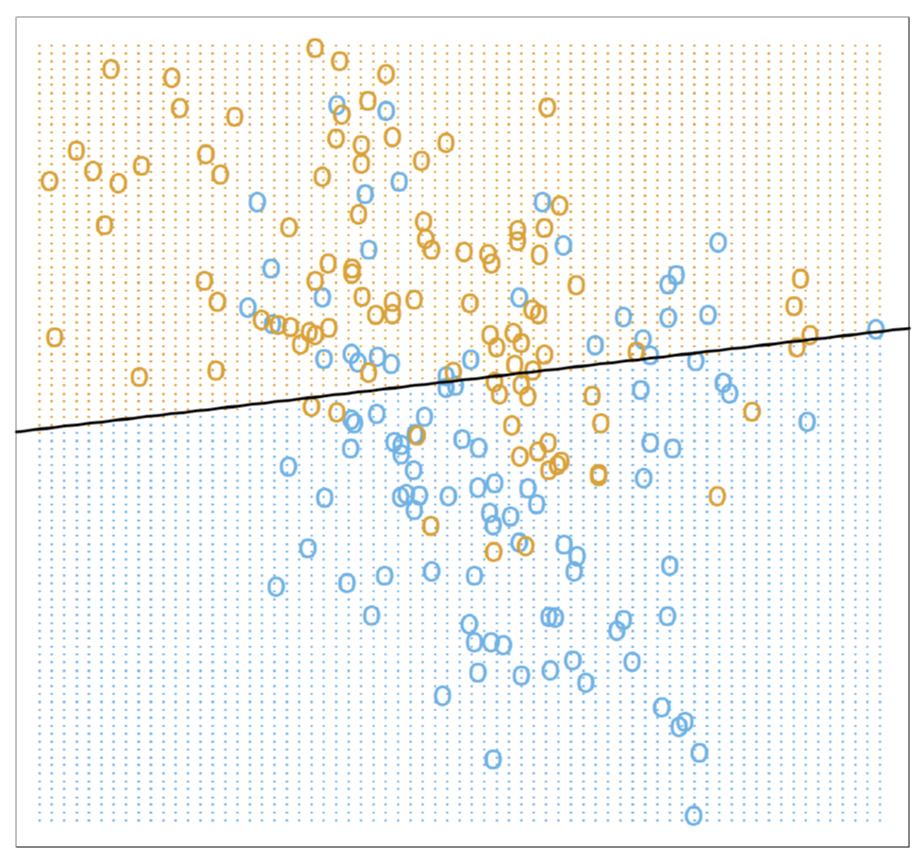
A Toy Example
200 points simulated from an unknown distribution; 100 in each of two classes {BLUE, ORANGE}. Can we build a rule to predict the color of future points?

Slide 13
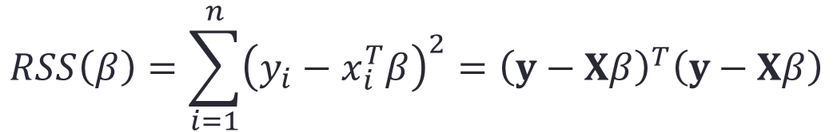
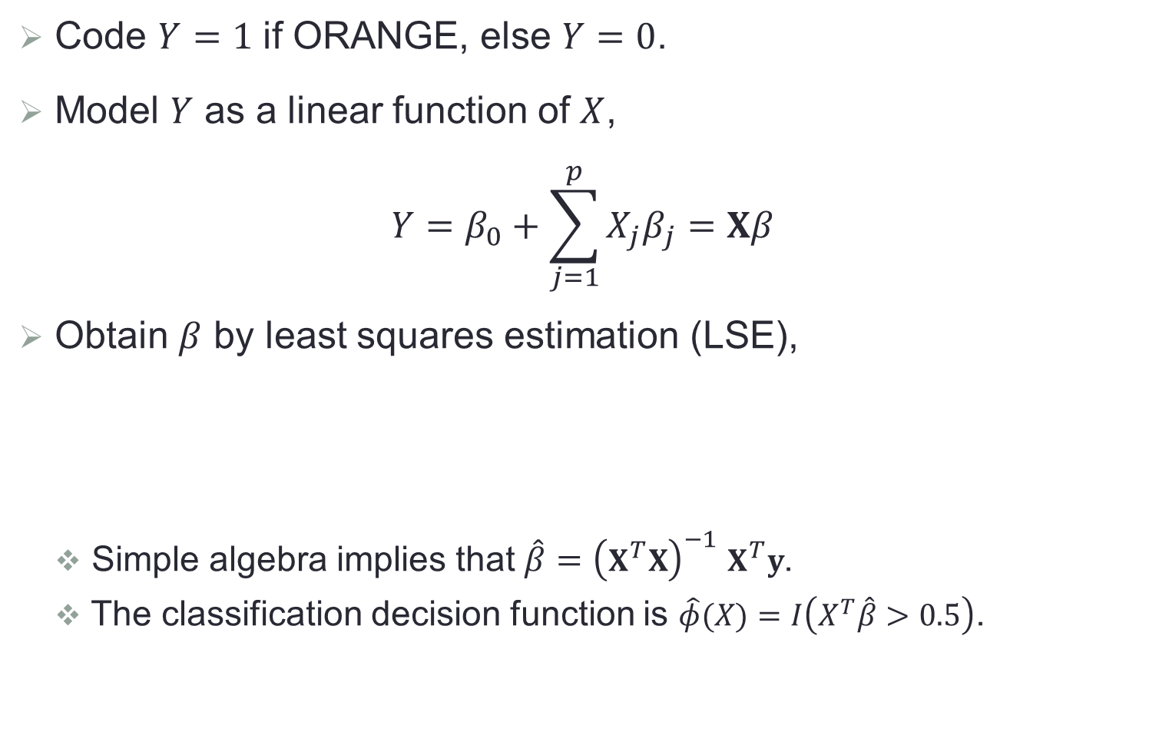
Model 1: Linear Regression
Code $Y=1$ if ORANGE, else $Y=0$.
Model $Y$ as a linear function of $X$,
$$Y=β_{0}+\sum_{j=1}^{p}{X_{j}β_{j}}=Xβ$$
Obtain $β$ by least squares estimation (LSE),
Simple algebra implies that $\hat{β}={\left(X^{T}X\right)}^{−1}$ $X^{T}y$.
The classification decision function is $\hat{φ}(X)=I\left(X^{T}\hat{β}>0.5\right)$.
$$RSS\left(β\right)=\sum_{i=1}^{n}{{\left(y_{i}−x_{i}^{T}β\right)}^{2}}={\left(y−Xβ\right)}^{T}\left(y−Xβ\right)$$

Slide 14
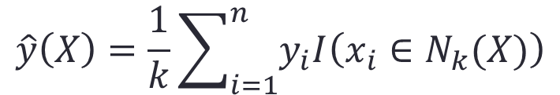
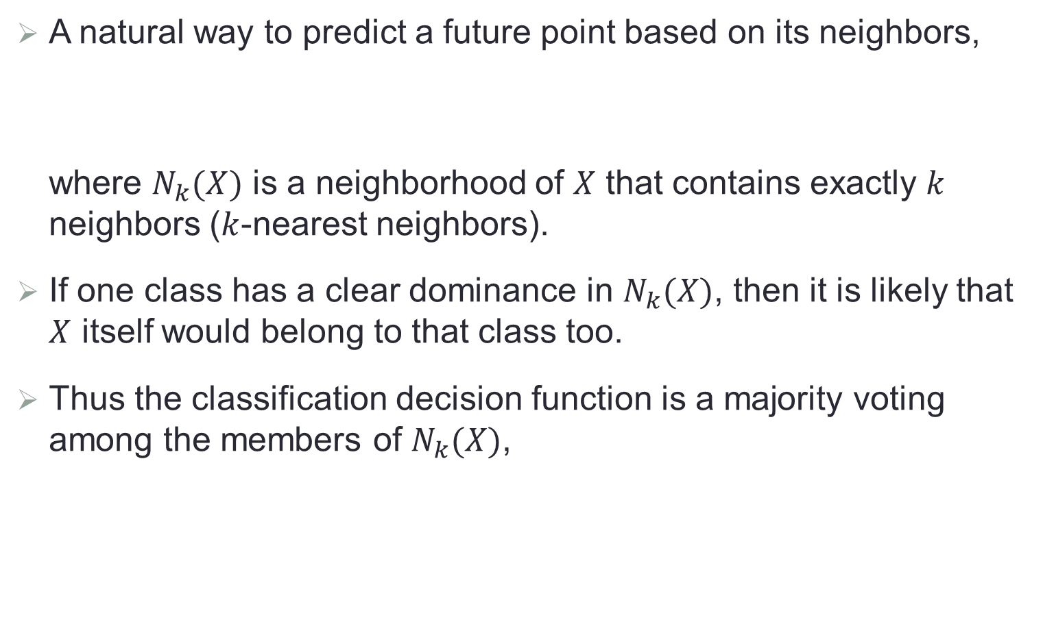

Model 2: Nearest Neighbors
A natural way to predict a future point based on its neighbors,
where $N_{k}(X)$ is a neighborhood of $X$ that contains exactly $k$ neighbors ($k$-nearest neighbors).
If one class has a clear dominance in $N_{k}(X)$, then it is likely that $X$ itself would belong to that class too.
Thus the classification decision function is a majority voting among the members of $N_{k}(X)$,
$$\hat{y}\left(X\right)=\frac{1}{k}\sum_{i=1}^{n}{y_{i}I\left(x_{i}∈N_{k}(X)\right)}$$
$$\hat{φ}(X)=I\left(\hat{y}\left(X\right)>0.5\right)$$

Slide 15
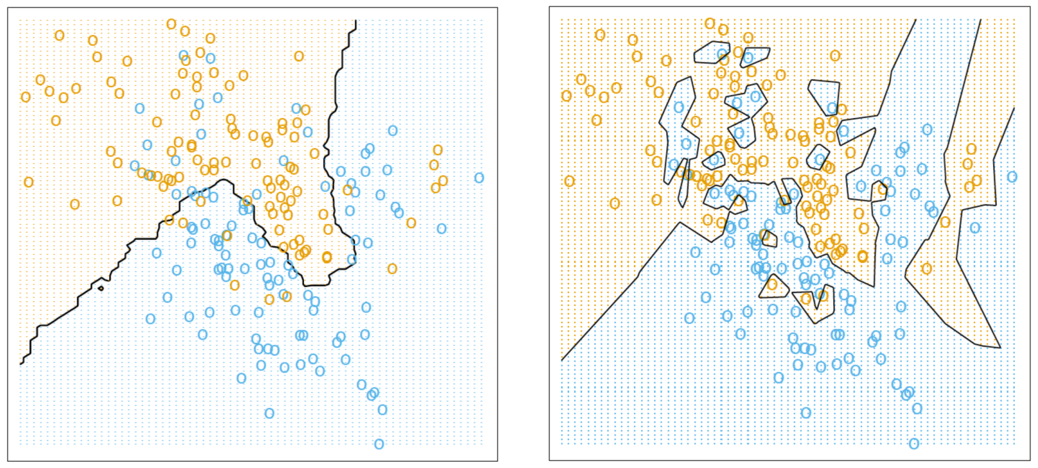
Nearest Neighbors

Slide 16
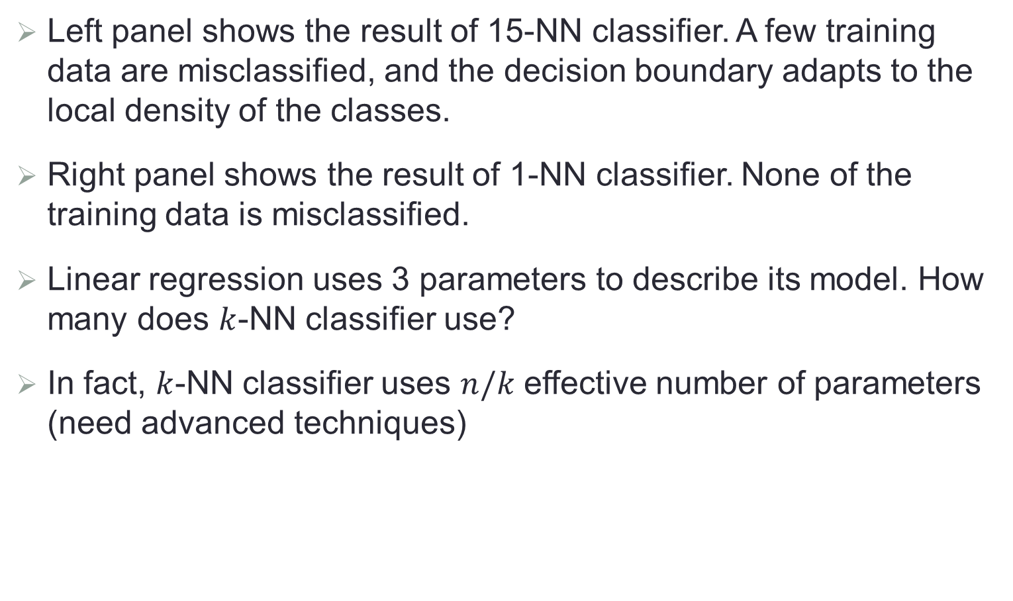
The Figures
Left panel shows the result of 15-NN classifier. A few training data are misclassified, and the decision boundary adapts to the local density of the classes.
Right panel shows the result of 1-NN classifier. None of the training data is misclassified.
Linear regression uses 3 parameters to describe its model. How many does $k$-NN classifier use?
In fact, $k$-NN classifier uses $n/k$ effective number of parameters (need advanced techniques)

Slide 17

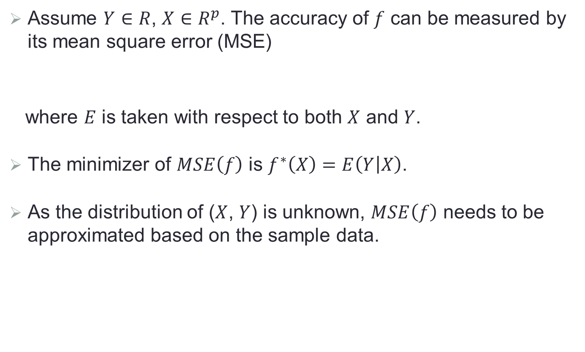
Model Assessment for Regression
Assume $Y∈R$, $X∈R^{p}$. The accuracy of $f$ can be measured by its mean square error (MSE)
where $E$ is taken with respect to both $X$ and $Y$.
The minimizer of $MSE\left(f\right)$ is $f^{∗}\left(X\right)=E\left(Y | X\right)$.
As the distribution of ($X$, $Y$) is unknown, $MSE\left(f\right)$ needs to be approximated based on the sample data.
$$MSE\left(f\right)=E{\left(Y−f(X)\right)}^{2}$$

Slide 18
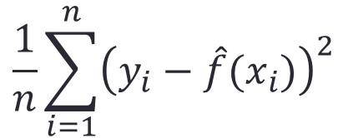
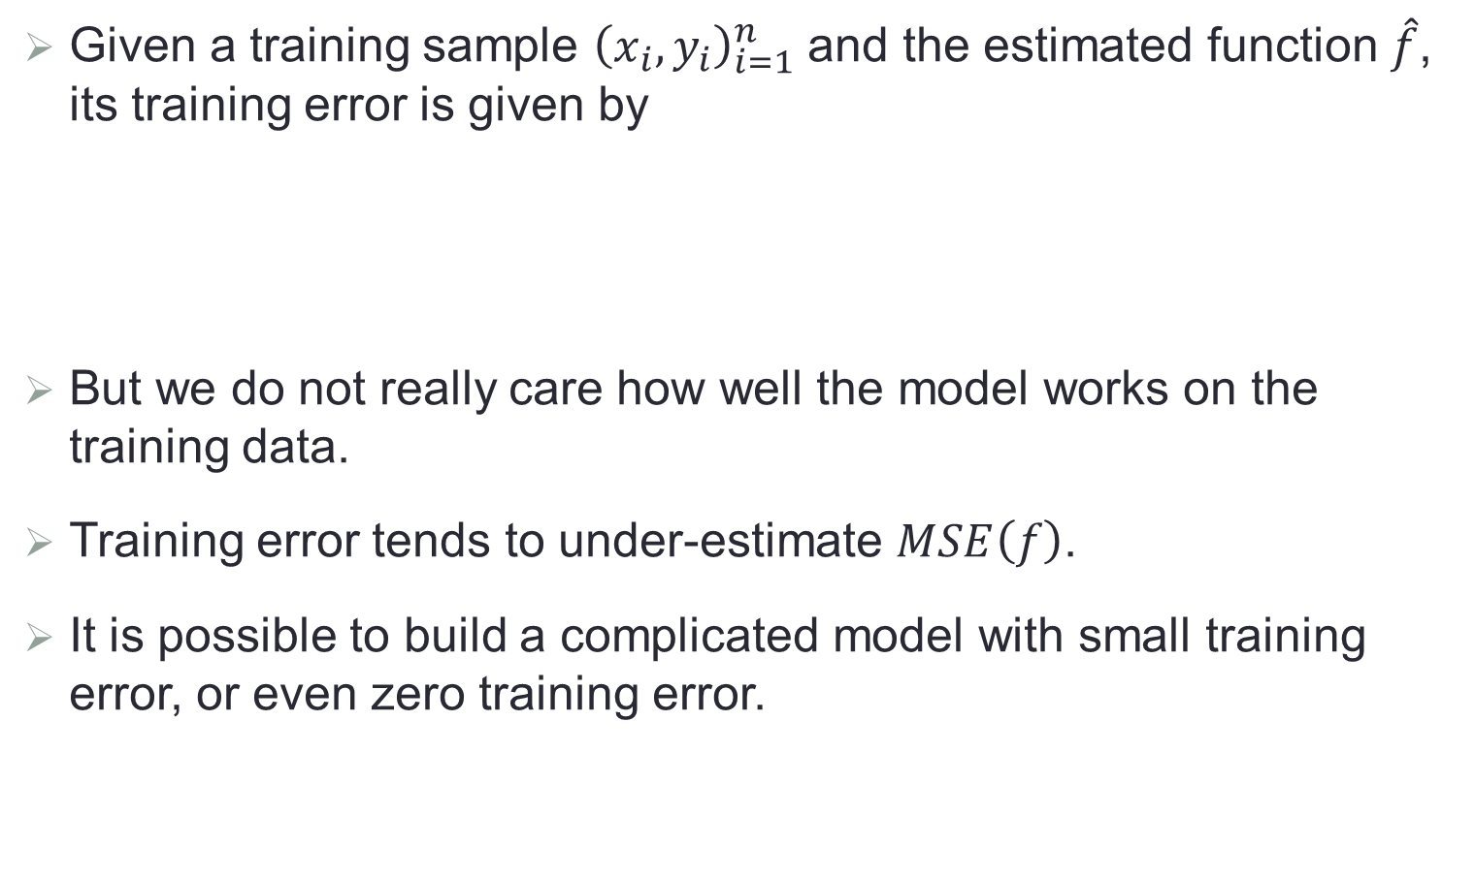
Training Error
Given a training sample ${\left(x_{i},y_{i}\right)}_{i=1}^{n}$ and the estimated function $\hat{f}$, its training error is given by
But we do not really care how well the model works on the training data.
Training error tends to under-estimate $MSE\left(f\right)$.
It is possible to build a complicated model with small training error, or even zero training error.
$$\frac{1}{n}\sum_{i=1}^{n}{{\left(y_{i}−\hat{f}(x_{i})\right)}^{2}}$$

Slide 19
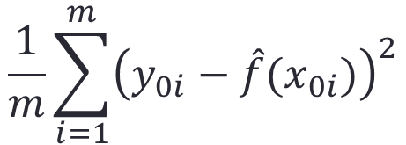
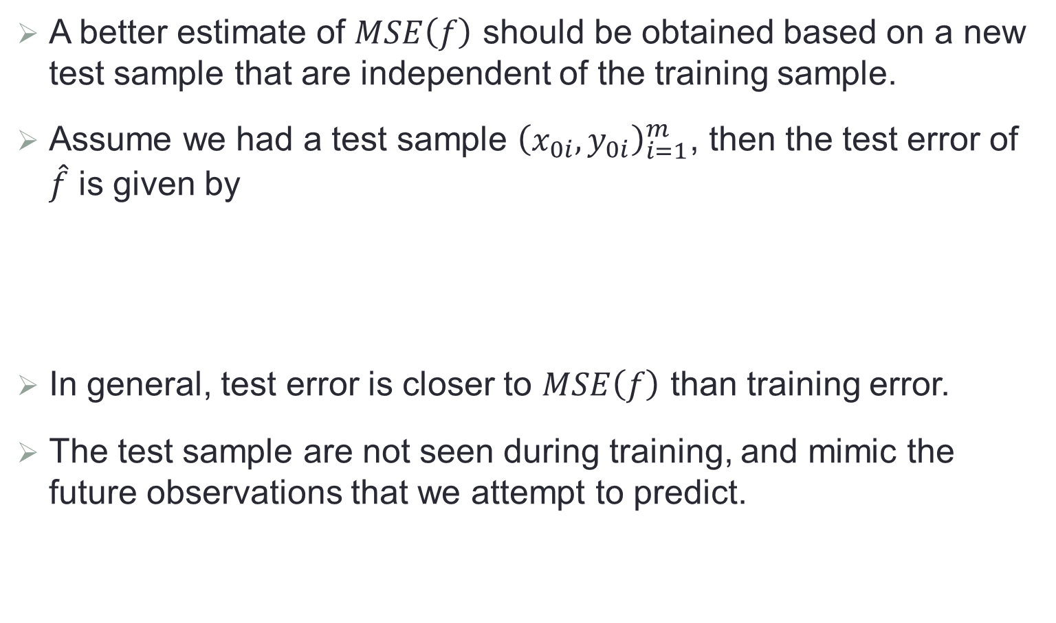
Test Error
A better estimate of $MSE\left(f\right)$ should be obtained based on a new test sample that are independent of the training sample.
Assume we had a test sample ${\left(x_{0i},y_{0i}\right)}_{i=1}^{m}$, then the test error of $\hat{f}$ is given by
In general, test error is closer to $MSE\left(f\right)$ than training error.
The test sample are not seen during training, and mimic the future observations that we attempt to predict.
$$\frac{1}{m}\sum_{i=1}^{m}{{\left(y_{0i}−\hat{f}(x_{0i})\right)}^{2}}$$

Slide 20
Training/Test Errors of Smoothing Spline

Slide 21
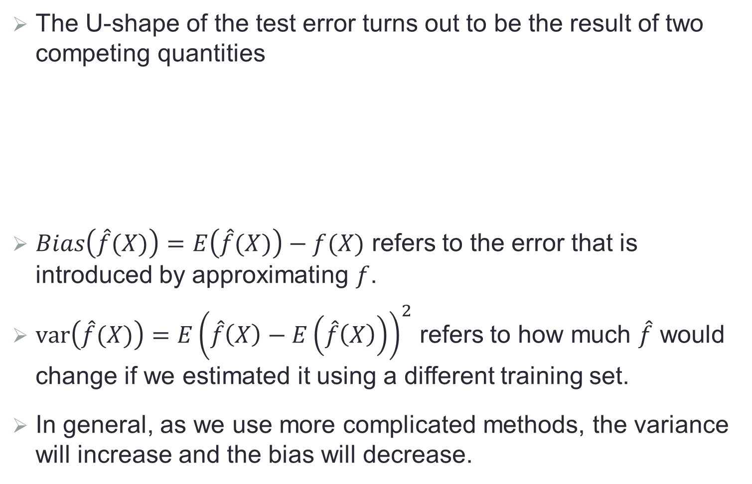
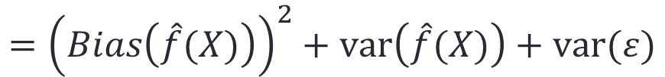
Bias-Variance Decomposition
The U-shape of the test error turns out to be the result of two competing quantities
$Bias\left(\hat{f}(X)\right)=E\left(\hat{f}(X)\right)−f(X)$ refers to the error that is introduced by approximating $f$.
$var\left(\hat{f}(X)\right)=E{\left(\hat{f}\left(X\right)−E\left(\hat{f}\left(X\right)\right)\right)}^{2}$ refers to how much $\hat{f}$ would change if we estimated it using a different training set.
In general, as we use more complicated methods, the variance will increase and the bias will decrease.
$$E{\left(Y−\hat{f}(X)\right)}^{2}=E{\left(\hat{f}\left(X\right)−f(X)\right)}^{2}+var(ε)$$
$$={\left(Bias\left(\hat{f}(X)\right)\right)}^{2}+var\left(\hat{f}(X)\right)+var(ε)$$

Slide 22
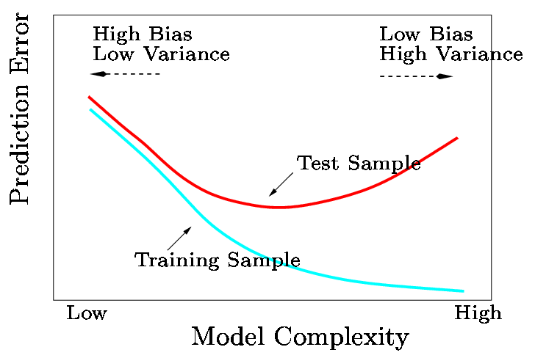
A Fundamental Picture
In general, training errors always decline as flexibility (complexity) increases.
However, test error shows a U-shape:
  decline at first (as reduction in bias dominates)
  then start to increase again (as increase in variance dominates).

Slide 23

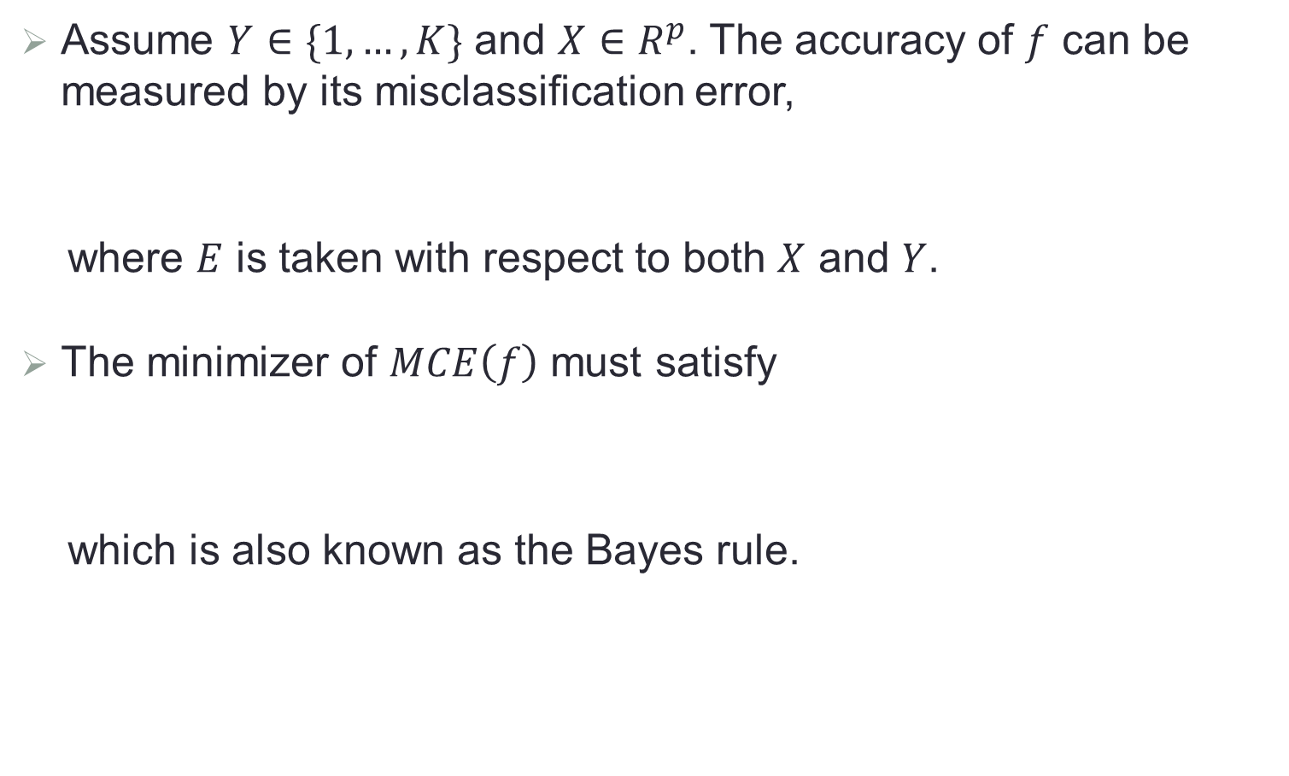

Model Assessment for Classification
Assume $Y∈\{1,…,K\}$ and $X∈R^{p}$. The accuracy of $f$ can be measured by its misclassification error,
where $E$ is taken with respect to both $X$ and $Y$.
The minimizer of $MCE\left(f\right)$ must satisfy
which is also known as the Bayes rule.
$$MCE\left(f\right)=E\left(I\left(Y≠f(X)\right)\right)$$
$$f^{∗}\left(X\right)=arg\max_{k}{P\left(Y=k|X\right)}$$

Slide 24
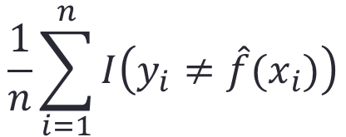
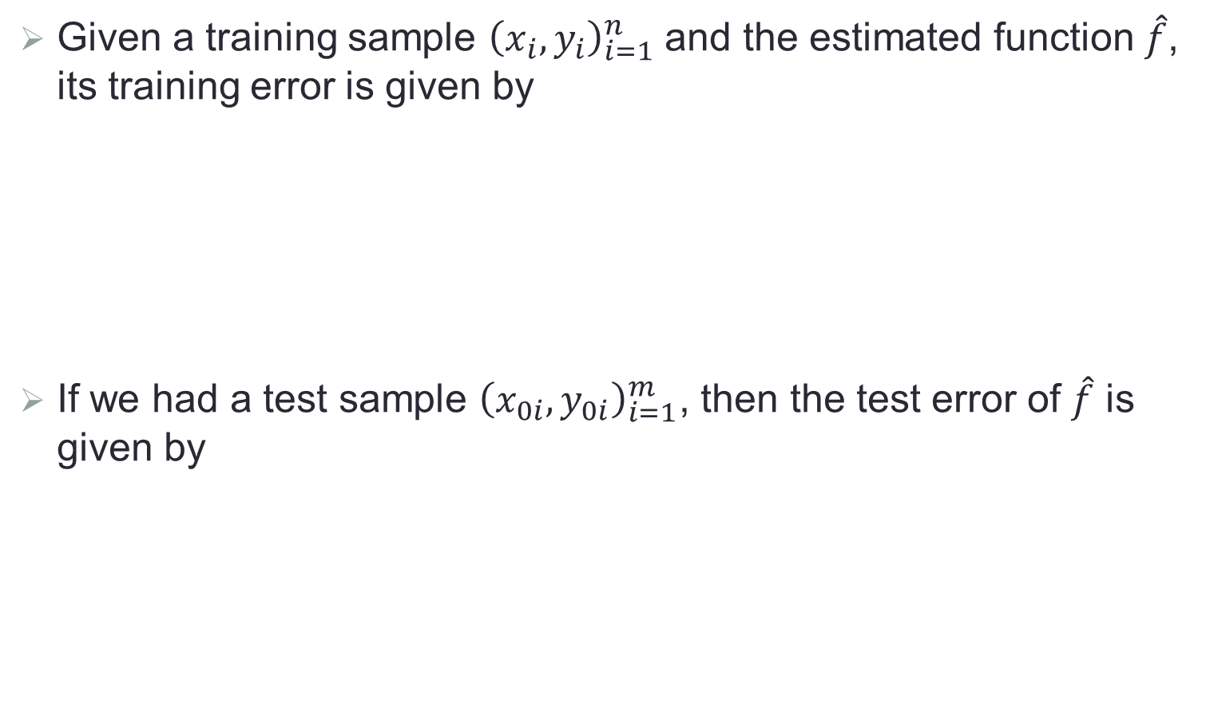
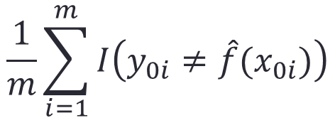
Training and Test Errors
Given a training sample ${\left(x_{i},y_{i}\right)}_{i=1}^{n}$ and the estimated function $\hat{f}$, its training error is given by
If we had a test sample ${\left(x_{0i},y_{0i}\right)}_{i=1}^{m}$, then the test error of $\hat{f}$ is given by
$$\frac{1}{n}\sum_{i=1}^{n}{I\left(y_{i}≠\hat{f}(x_{i})\right)}$$
$$\frac{1}{m}\sum_{i=1}^{m}{I\left(y_{0i}≠\hat{f}(x_{0i})\right)}$$

Slide 25
Training/Test Errors of KNN

Slide 26
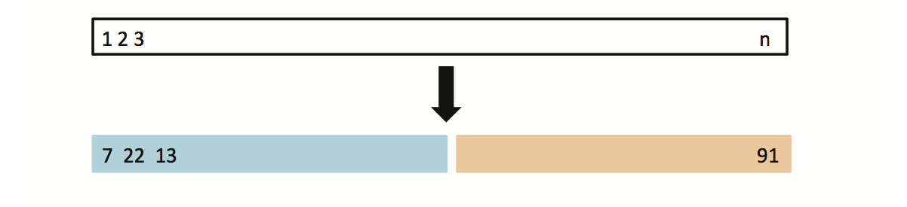
Test Error in Practice
In practice, a large designated test set is often unavailable.
Some adjustments can be made to the training error in order to estimate the test error: AIC, BIC, Covariance penalty.
If we have a large training set, we can estimate the test error by randomly splitting the data into training and validation parts.
Use the training part to build model, and then assess the model by applying it to the validation part.

Slide 27
Validation Set Approach
Advantages
Simple idea
Easy to implement
Disadvantages
The validation MSE can be highly variable.
Only a subset of observations are used to fit the model, while statistical methods tend to perform worse when trained on fewer observations.

Slide 28
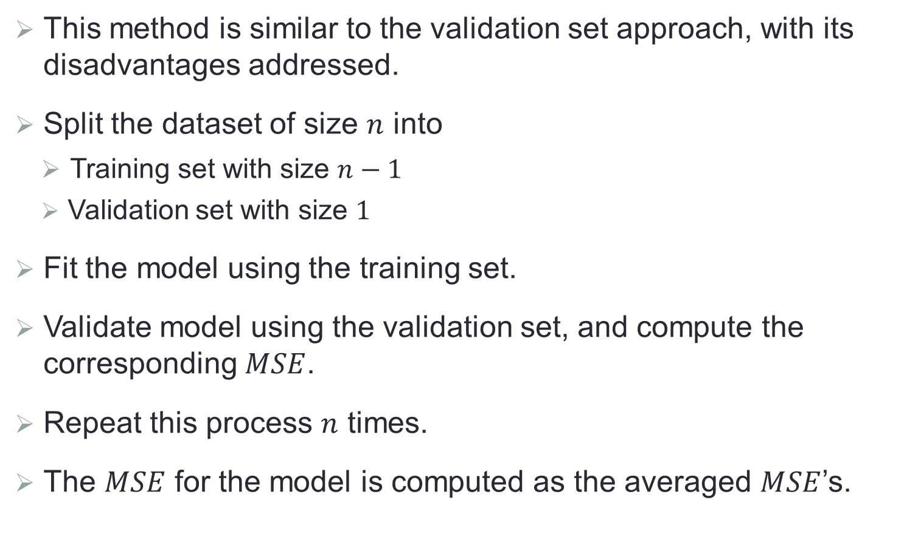
Leave-One-Out Cross Validation (LOOCV)
This method is similar to the validation set approach, with its disadvantages addressed.
Split the dataset of size $n$ into
Training set with size $n−1$
Validation set with size $1$
Fit the model using the training set.
Validate model using the validation set, and compute the corresponding $MSE$.
Repeat this process $n$ times.
The $MSE$ for the model is computed as the averaged $MSE$’s.

Slide 29
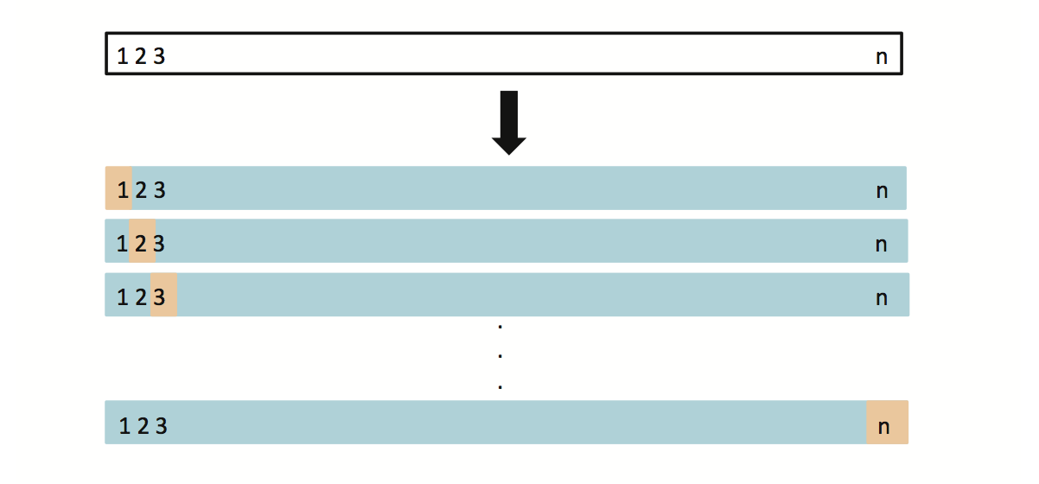
LOOCV

Slide 30
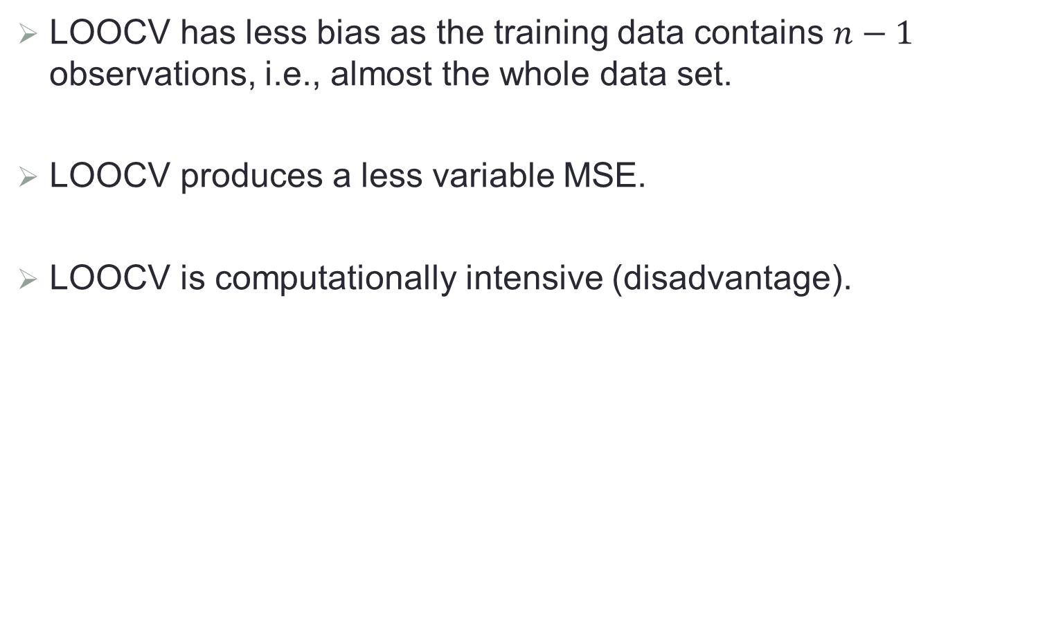
LOOCV vs. Validation Set Approach
LOOCV has less bias as the training data contains $n−1$ observations, i.e., almost the whole data set.
LOOCV produces a less variable MSE.
LOOCV is computationally intensive (disadvantage).

Slide 31
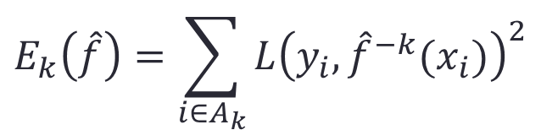
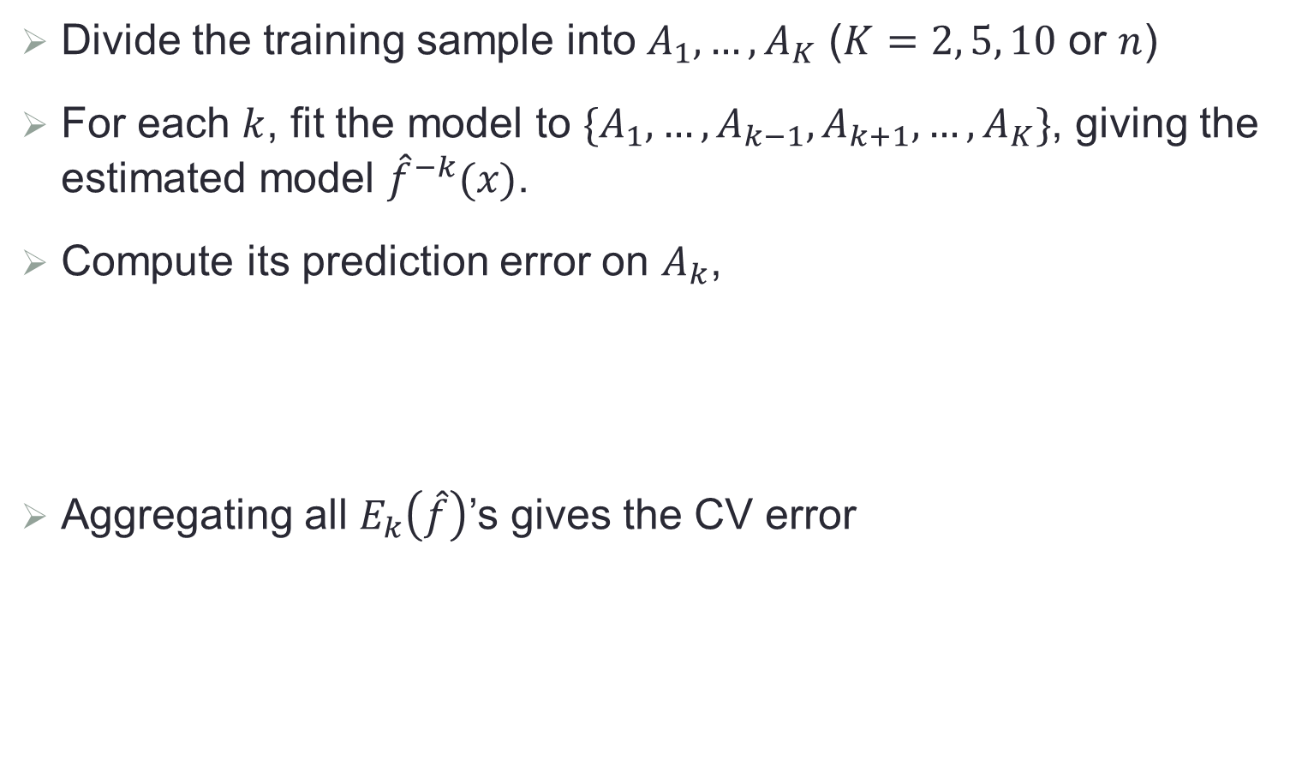
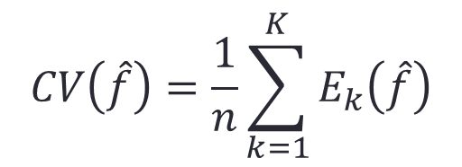
K-Fold CV
Divide the training sample into $A_{1},…,A_{K}$ ($K=2, 5, 10$ or $n$)
For each $k$, fit the model to $\{A_{1},…,A_{k−1},A_{k+1},…,A_{K}\}$, giving the estimated model ${\hat{f}}^{−k}(x)$.
Compute its prediction error on $A_{k}$,
Aggregating all $E_{k}\left(\hat{f}\right)$’s gives the CV error
$$E_{k}\left(\hat{f}\right)=\sum_{i∈A_{k}}{L{\left(y_{i},{\hat{f}}^{−k}(x_{i})\right)}^{2}}$$
$$CV\left(\hat{f}\right)=\frac{1}{n}\sum_{k=1}^{K}{E_{k}\left(\hat{f}\right)}$$

Slide 32
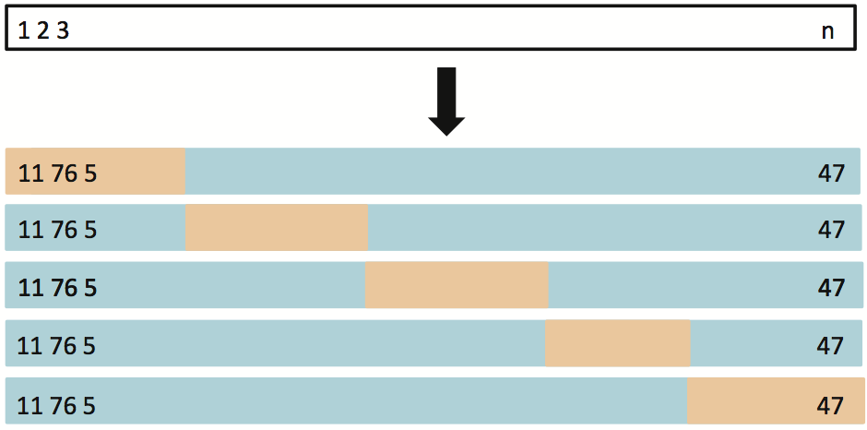
Cross Validation

Slide 33
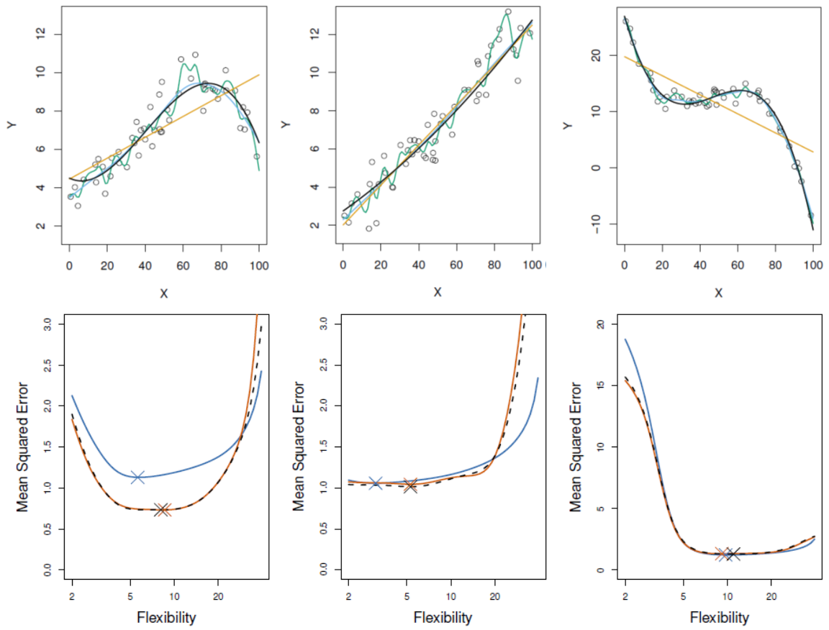
Three Simulated Examples
Blue: test error; Black: LOOCV; Orange: 10-fold CV

Slide 34
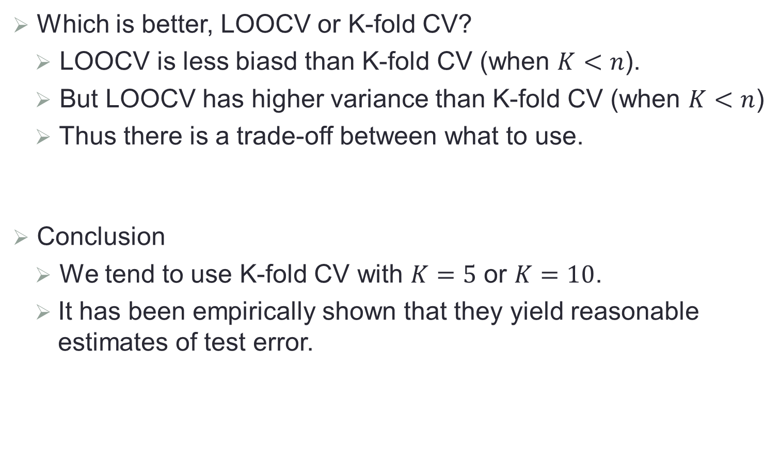
Comments
Which is better, LOOCV or K-fold CV?
LOOCV is less biasd than K-fold CV (when $K<n$).
But LOOCV has higher variance than K-fold CV (when $K<n$)
Thus there is a trade-off between what to use.
Conclusion
We tend to use K-fold CV with $K=5$ or $K=10$.
It has been empirically shown that they yield reasonable estimates of test error.

